Slide 1

P6 Renewvia - design
Taylor Boyd, Enming Li, Taylor Nguyen, Dharshan Rammohan

Slide 2
Members and Roles
Taylor Boyd
To research related works and propose methods to the team regarding initial parameterization and approach to determining pole count and locations (i.e. clustering, etc.).
Enming Li
To research related works & propose methods to the team regarding ways to find all possible grid designs (connectivity) within given constraints, assuming candidate pole count and locations have been determined.
*Note that, while we all started off doing different research to help propose initial ideas (listed on right), we are all working on the team’s class requirements, our project's optimization, and a research paper to detail our methodology.
Taylor Nguyen
To research related works and propose methods to the team regarding initial parameterization and approach to determining pole count and locations (i.e. clustering, etc.).
Dharshan Rammohan
To research related works & propose methods to the team regarding ways to find all possible grid designs (connectivity) within given constraints, assuming candidate pole count and locations have been determined.

Slide 3
Renewvia Energy
Our partner organization is Renewvia Energy. Our partner at Renewvia, Nicholas Selby, proposed bi-weekly meetings to check in on progress; these meetings have been taking place every other Wednesday 3-4pm UTC. The deliverables for the semester include an approach to solving the graph problem presented as well as documentation for the project (a research paper).

Slide 4
Renewvia Solar Mini-Grid Powerline Distribution networks design
The goal of our team is to produce a viable solution to the graph theory problem proposed by Nicholas Selby at Renewvia. More specifically, we hope to create a model for automating electricity grid pole and cable distribution such that the results include an optimal, cost-saving design for a given community. As recommended to us by Nicholas, we decided to think of the project as having two parts: parameterization and optimization.
The parameterization phase involves analyzing test data, proposing potential pole locations, and determining how to represent a feasible energy grid design that adheres to the specified constraints.
The optimization phase focuses on refining these proposed designs to identify the most cost-efficient solution, leveraging hyperparameters to minimize overall costs.
*no sensitive data was used

Slide 5
Project Chronology
February 18 – Idea Generation and Proposal
Developed and proposed a range of solution ideas to Nicholas:
Clustering algorithms (e.g., K-means, DBSCAN)
Mixed-Integer Linear Programming (MILP)
Steiner Tree and Greedy MST with pruning
Directed Acyclic Graph (DAG) representations.
Minimum Circle Covering and hexagonal grid approaches.
Final proposed approach:
Use Minimum Circle Covering (MCC) for initial pole placement
Represent the setup as a DAG (nodes: poles/buildings; edges: cables)
Feed DAG into a Graph Neural Network (GNN) to optimize using Stochastic Gradient Descent (SGD)
Incorporate Simulated Annealing (SA) or Genetic Algorithms (GA) for optimization heuristics.
February 12 – Project Kickoff and Problem Definition
Meeting with Nicholas (partner) to understand the problem and gather key constraints
February 25 – Partner Feedback and Framework Refinement
February 14 – Initial Research
Nicholas agreed on trying:
Minimum Disk Covering or K-means for pole candidates
Model problem as DAG with edge types (LV, MV, drop cables)
Considered using:
Graph Attention Networks (GAT) for edge-type handling
Graph Convolutional Networks (GCN) for efficiency
Graph Transformers for extended capabilities
Optimization strategy:
Reinforcement Learning (RL) with Proximal Policy Optimization (PPO)
Surveyed academic papers to identify prior work or existing solutions.
Found partial overlaps but no complete or directly applicable solutions.
February 16 – Project Webpage
Created a public webpage to document the project.
Included key information, goals, and work in progress.

Slide 6
Project Chronology Cont.
March 18 – UI Improvements and Simplified Baseline
Improved UI for better usability
Simplified algorithm (temporarily excluding transformers) to create a basic working version of the grid.
March 3 – Feedback from Professor Vempala
Advised to:
Build a front end for data input.
Implement a baseline algorithm for grid generation.
Include evaluation features (e.g., cost, pole count).
March 26 – Larger Datasets and Algorithm Work
Created two new, larger test datasets based on locations from Nicholas
Continued working on:
Graph Convolutional Network (GCN).
Integer Linear Programming (ILP) to generate optimized grid layouts.
March 16 – Frontend and Test Data
April 2 – ILP Results and Ongoing GCN Work
Built web frontend to accept CSV input (building and source locations + costs)
Backend processes the input and visualizes a baseline power grid
Created initial test datasets simulating real-world conditions.
Completed ILP implementation to minimize poles and optimize grid
Initial testing on large datasets showed promising ILP results
Ongoing efforts focused on improving and testing GCN algorithms to compare performance with ILP.

Slide 7
Architecture Details
Technology/Ideas
Disk Covering Problem
Integer Linear Programming
K-means as other option
Directed Acyclic Graph
Graph Neural Networks
GCN
Cost minimizing function v. Reinforcement Learning
Python
Python Libraries (scikit-learn, PuLP, etc)
Github
Vercel
Render

Slide 8
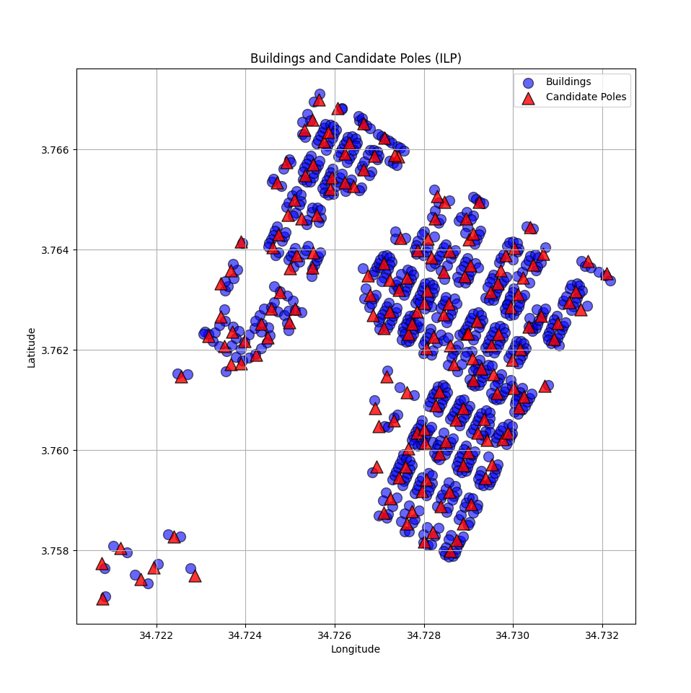
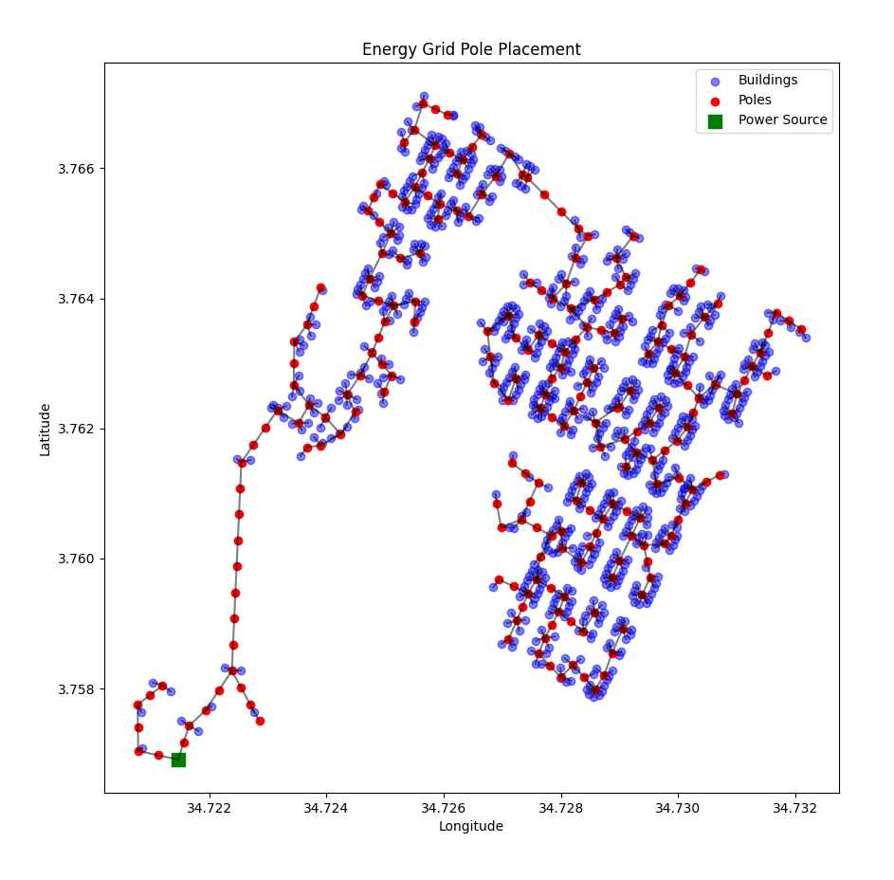
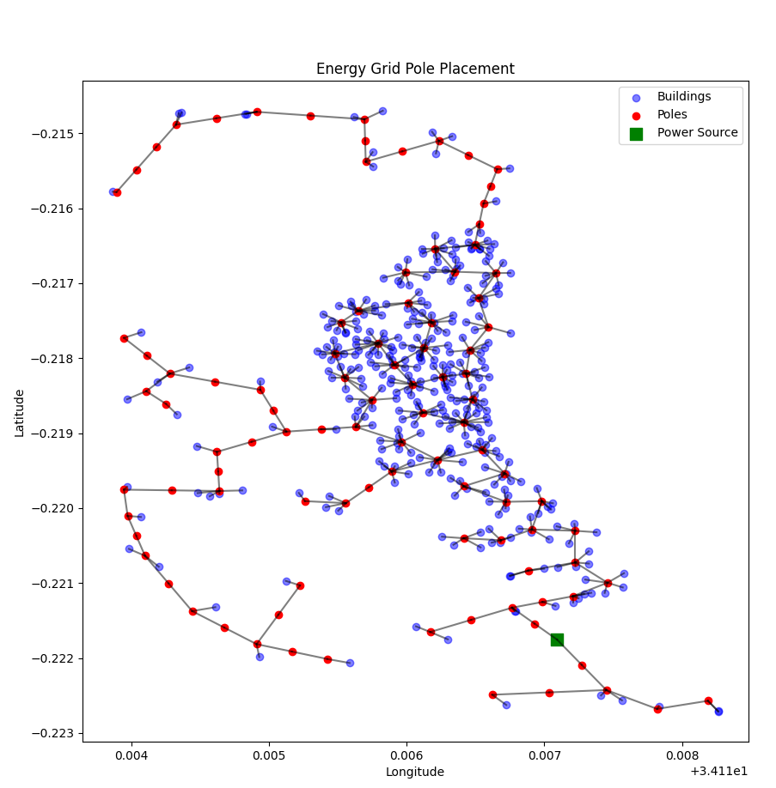
Minimum Disk Covering Problem
Problem
Find the fewest number of circles with a radius of (r) to enclose all points within a plane
Current Attempts
Use Integer Linear Programming and PuLP library

Slide 9
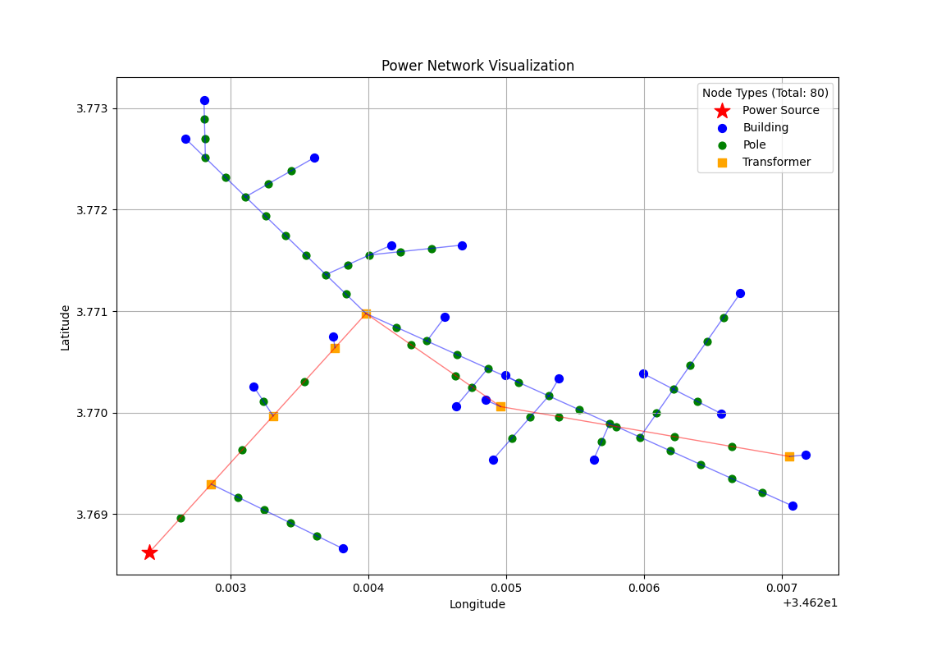
Directed Acyclic Graph (DAG)
Use
Advantages
Assuming fewest amount of valid poles are found, we can convert the problem to a graph problem by using DAGs
We can parameterize the graph using the DAG-tree subject to the constraints of the problem: :
MV cable length – 50 m
LV cable length – 30 m
Drop cable length – 20 m
Transformer nodes are added only when mv cables transition to LV cables or vice versa
This problem is naturally suited to this sort of structure, since we can make the poles the nodes and the wires the edges, and we know that we won’t have cycles within the power grid
This allows us to use efficient Dynamic Programming and Graph algorithms to find routes, or ML algorithms like Graph NNs
We can maintain a tree structure by enforcing that the edges are 1 less than the vertices

Slide 10
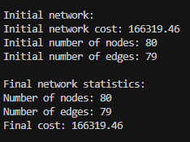
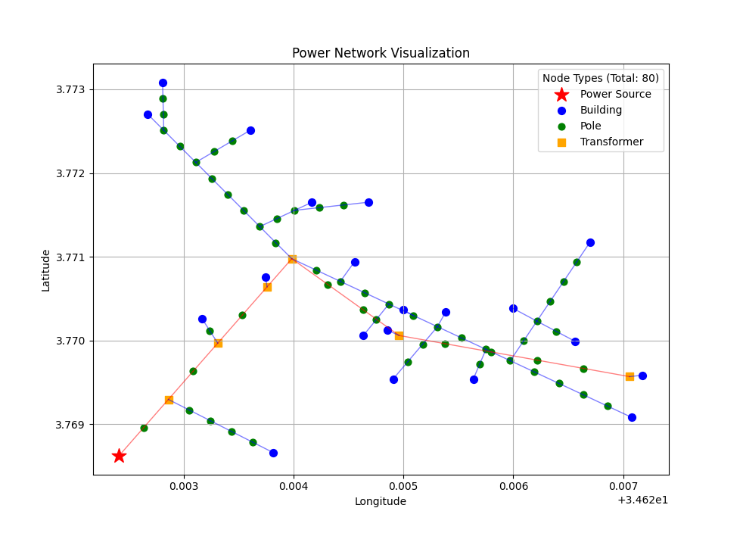
Graph Neural Networks
Pros / Cons
The graph NN gives us an easily digestible structural representation of a NN, while allowing for multiple data features to be internalized in a single node / edge – GD can do the optimization for you!
If unbounded, the state space can grow exponentially, leading to compute constraints
We chose the GCN because of ease of use and understanding vs the GAT
Uses
Since we can turn the problem into a graph representation, we can make use of graph NNs
This allows us to use ML to optimize the problem subject to multiple constraints
GCN modifications
Replaced loss function with cost minimizing function using reinforcement learning
Incorporated shortest-path optimization for voltage drop

Slide 11
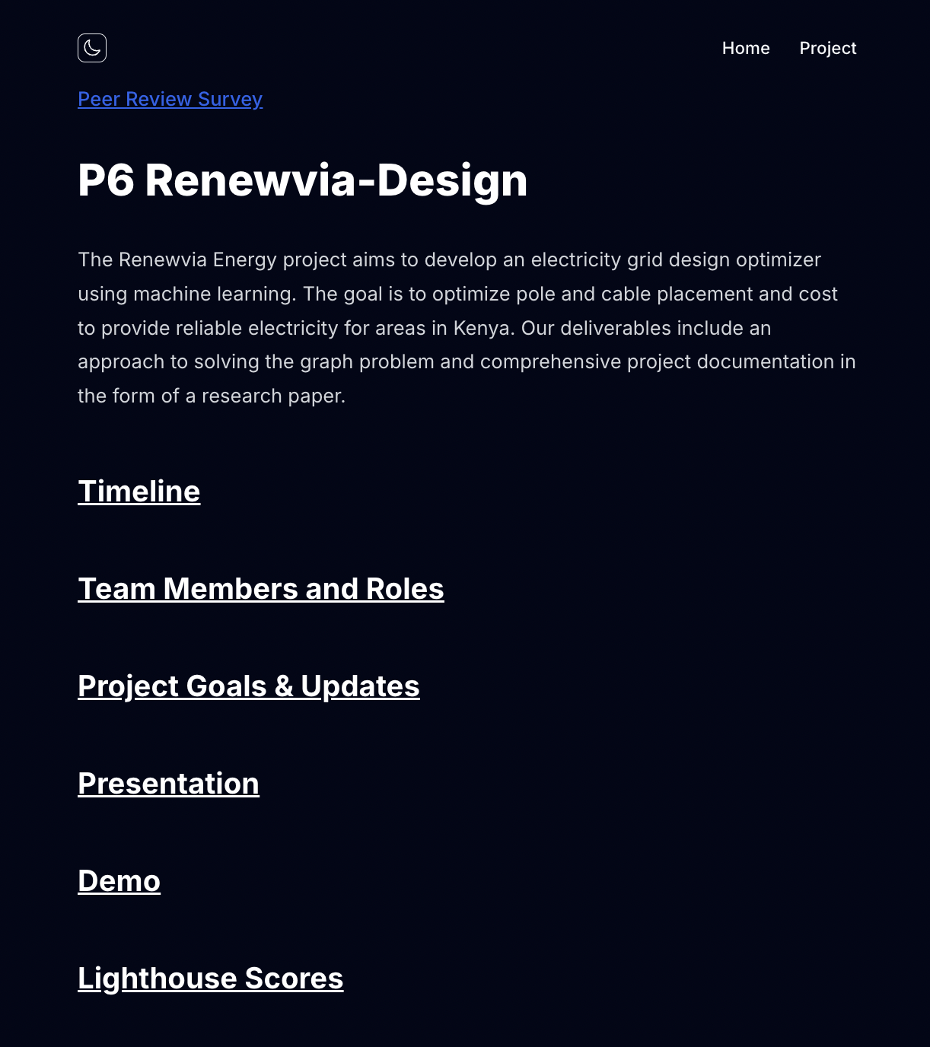
Final deliverables
Website
Share website we've made for class requirements
Github Code
Final Report
Share the code with our partner by either:
Sharing the repository access
Can also send code in zip file
Share Readme on how to run the code
Submit team research report detailing problem statement, background, methodology, related works, experiments, learning, challenges, sustainability analysis, etc.

Slide 12
Website
In addition to our efforts for finding a solar mini-grid design optimization solution, we created an interactive component to our website to help broader audiences understand the context of our problem. We added a ‘Project’ tab to our website where users may input their own test data and receive a visual of an ‘optimal’ grid design and total cost as output. This way, users can get a feel for what input and output for this problem might even look like and better understand the challenge. More details on what this looks like are in the following slides.
We also made sure to consider our peer feedback on this new feature of the website, and ended up adding more context in the ‘Project’ tab’s description that would hopefully better prepare users to interact with it.

Slide 13
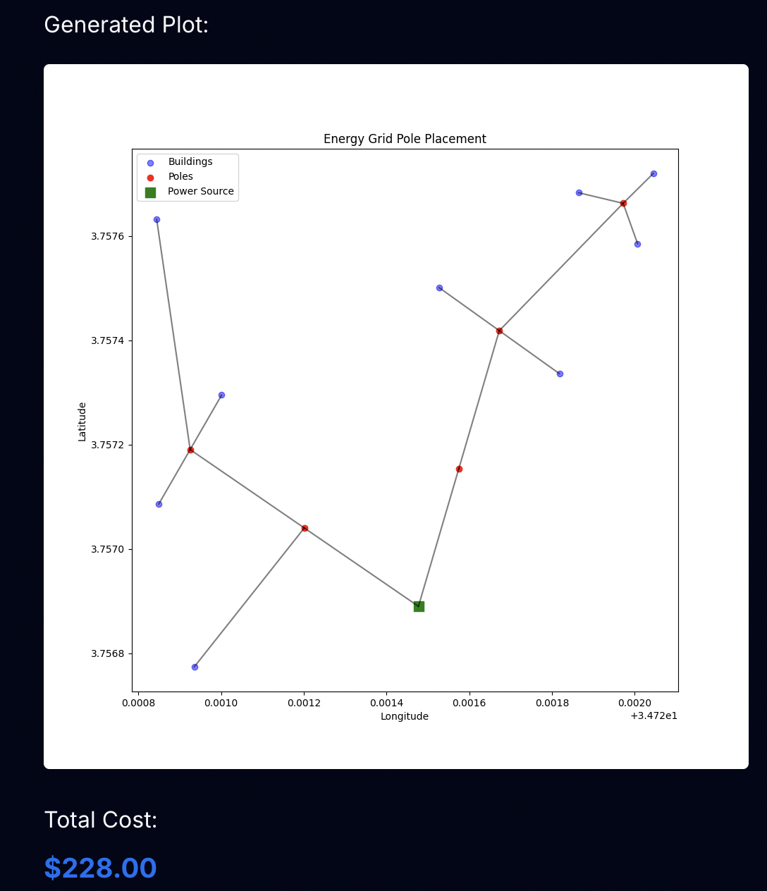
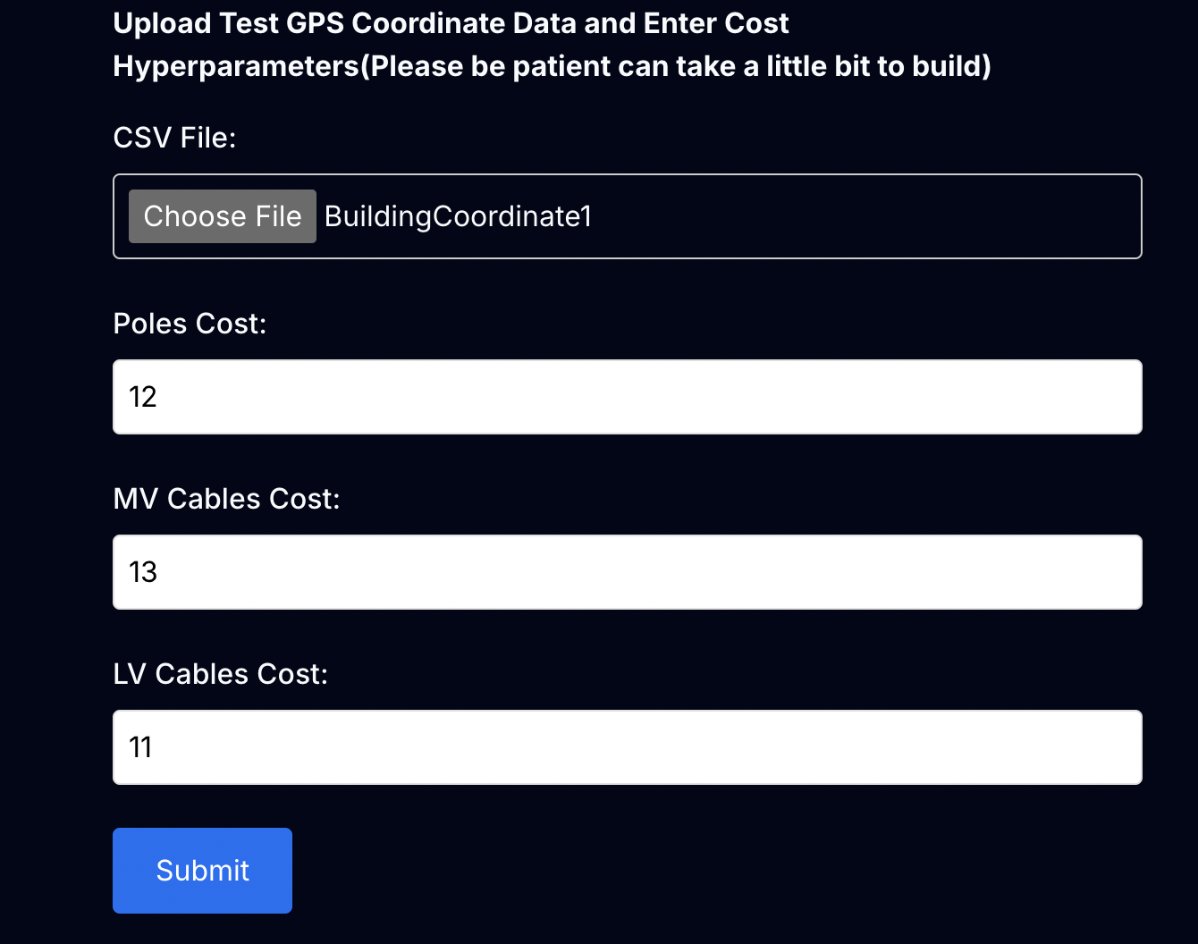
website project tab
Output:
User Input:
CSV file with building & power source coordinates (lat, long)
Hyperparameters:
Poles Cost
MV Cables Cost
LV Cables Cost
Graph for grid design with different nodes representing buildings, a power source, and poles. Edges represent cables connecting the buildings, poles and power source. It also outputs the total cost for the grid design below the visual.

Slide 14
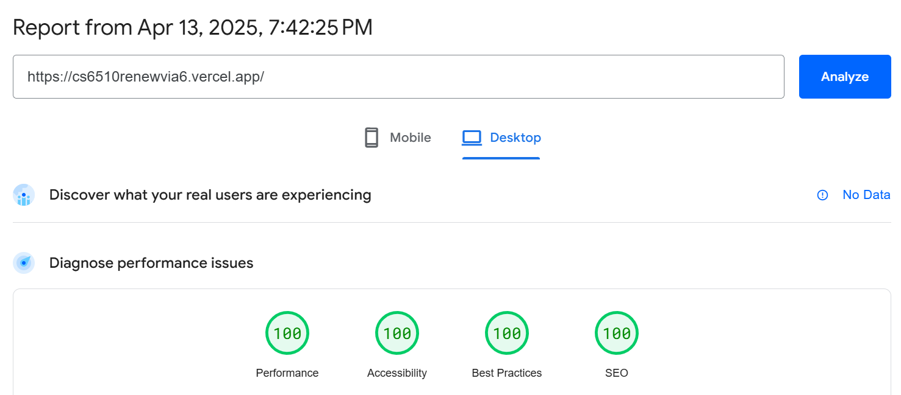

Homepage lighthouse scores
Desktop
Mobile
https://cs6510renewvia6.vercel.app/

Slide 15
Course principles
Sustainability
Github, Vercel, and Render
Modular code (Frontend UI and Backend Algorithm)
User Feedback Development
Improved Explanation for Frontend
Adapted design based on survey for partner/other users

